Slide 1

Truck Platooning
Presented by Zahid Parvez
Danish Zaheer Malik
Mohammad Rohail Usman
Qamar Sajjad

Slide 2
Motivation
To simulate the Truck Platooning scenario, which allows the following trucks to behave according to the commands send by the Leading Trucks.
Implementation of Machine Learning Algorthiums with respects to problem solving approach
Truck platooning to increase the efficieny , performance and automation .

Slide 3
Working
Select master with the help of knn calssifier on the bases of 2 parameter i.e distance from distination and number of sensors
The truck with the maximum master count will be set as a master/leading truck during the run time
In our scenario we have 1 Leading and 3 following trucks.
Master truck contain GPS coordinates while the slaves have no such property
Master contain data of all 3 slaves and itself
All other trucks contain only data of its front and back trucks.
With the help of the Timestamp of each truck that are following one another we determine there speed, direction and distance.

Slide 4
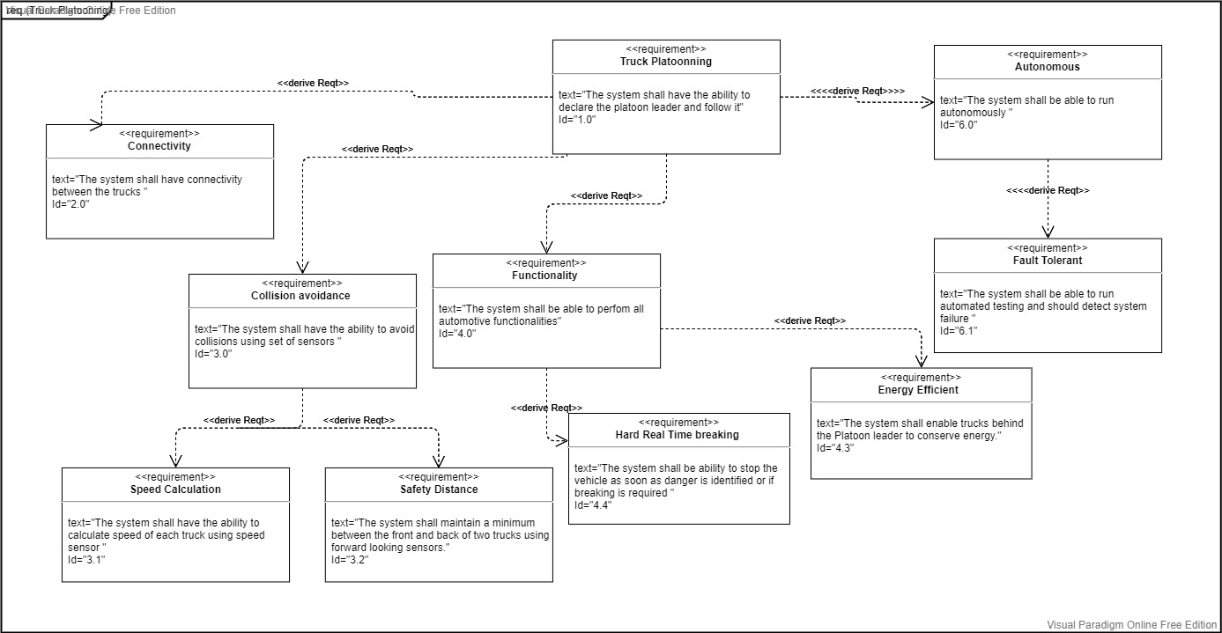
Requirement Diagram

Slide 5
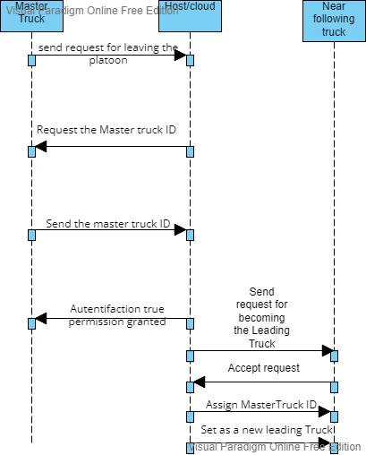
Sequence Diagram Scenario 1

Slide 6
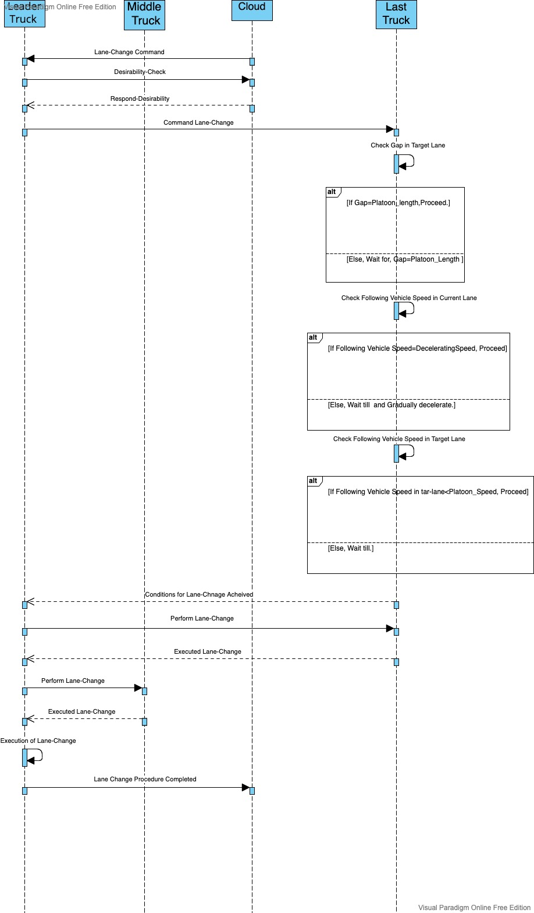
Lane-Change Scenario

Slide 7
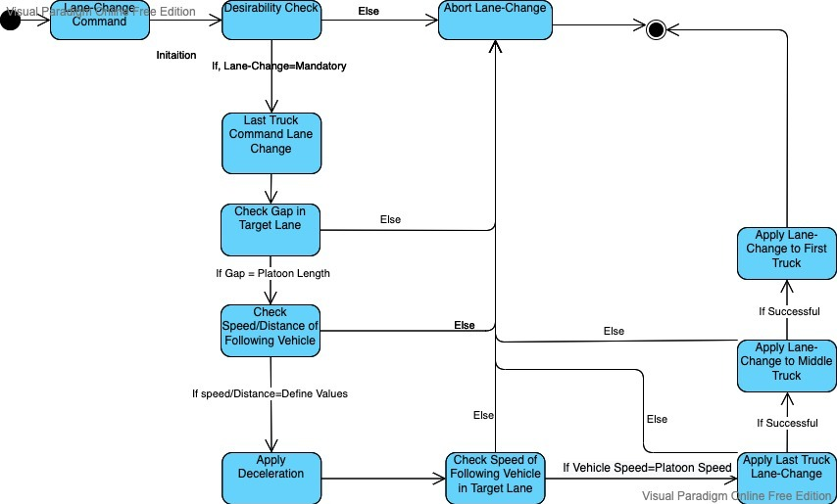
Lane-Change State Machine

Slide 8
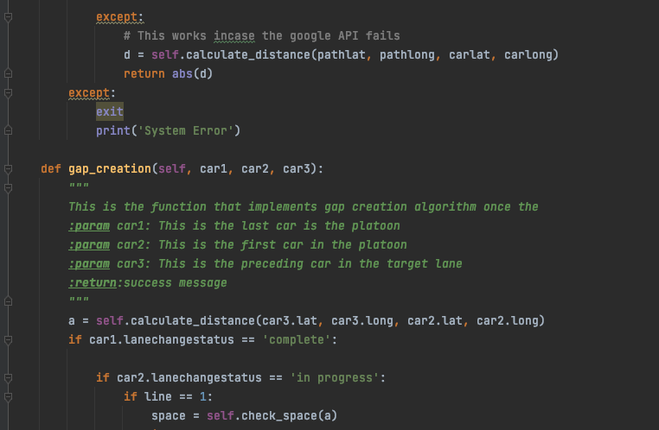
Lane-Change Scenario– Code Snippet

Slide 9
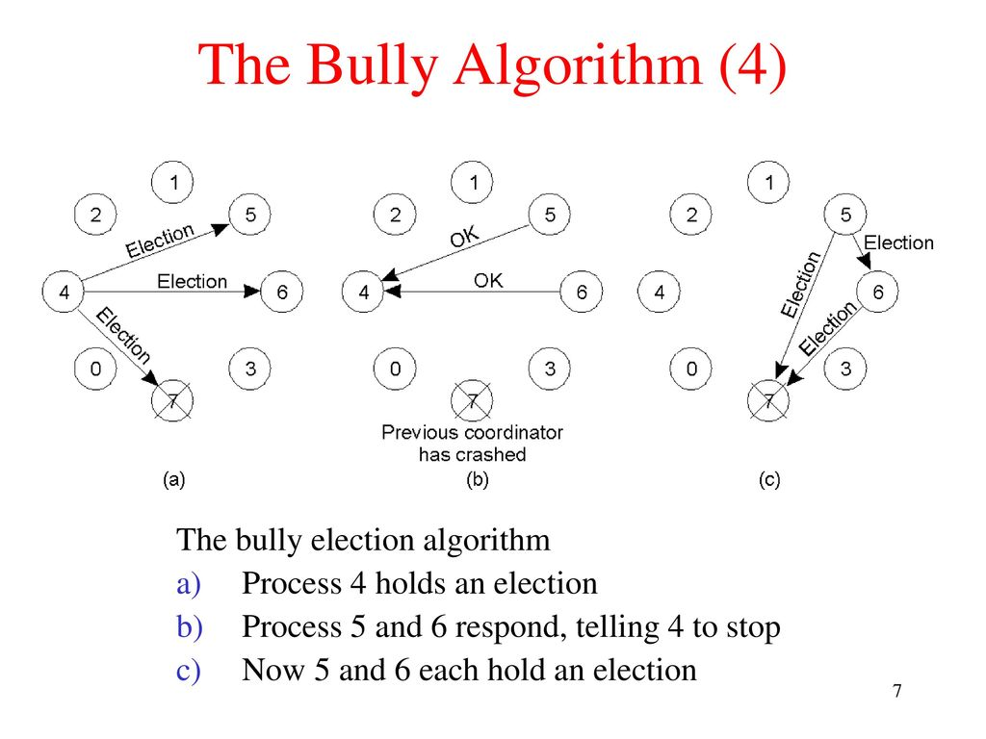
Leader-Election Algorithm – Bully Algorithm

Slide 10
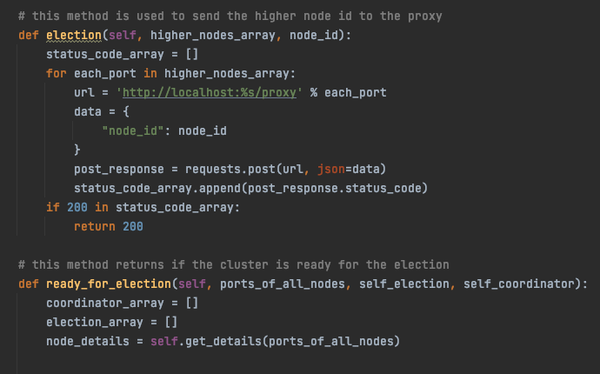
Leader-Election Algorithm– Code Snippet

Slide 11

KNN-Algorithm
Supervised Learning Technique
Assume Similarity b/w newcase and available case
Classifies a new data point based on the similarity
Can be used for Regression as well as for Classification
Non Parametric Algorithm

Slide 12

How KNN-Algorithm Work
Select the number K of the neighbors
Calculate the Euclidean distance of K number of neighbors
Take the K nearest neighbors as per the calculated Euclidean distance.
Among these k neighbors, count the number of the data points in each category.
Assign the new data points to that category for which the number of the neighbor is maximum.
Show the result

Slide 13
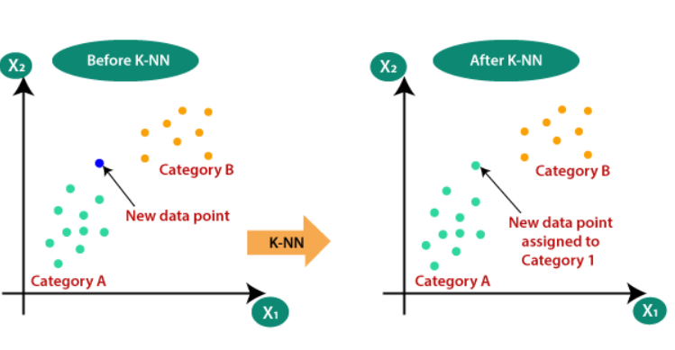
KNN-Algorithm Mechanism

Slide 14
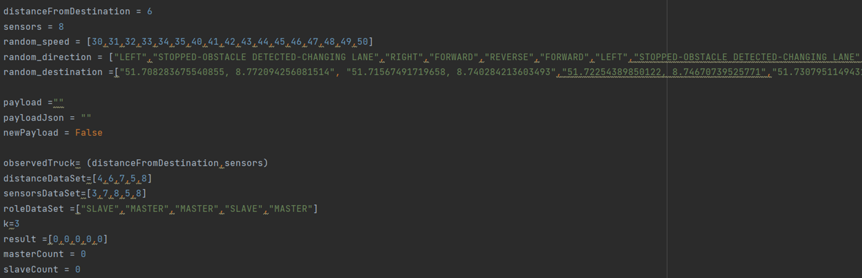
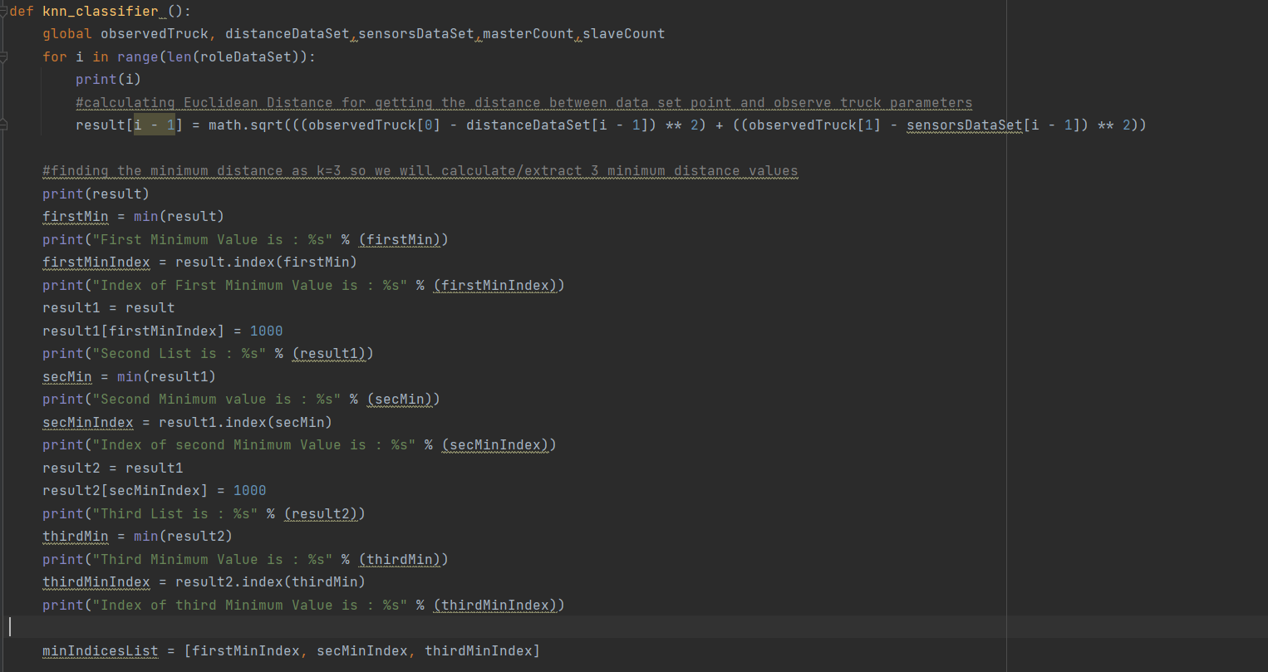
Euclidian Distance Measuring Algorithm

Slide 15
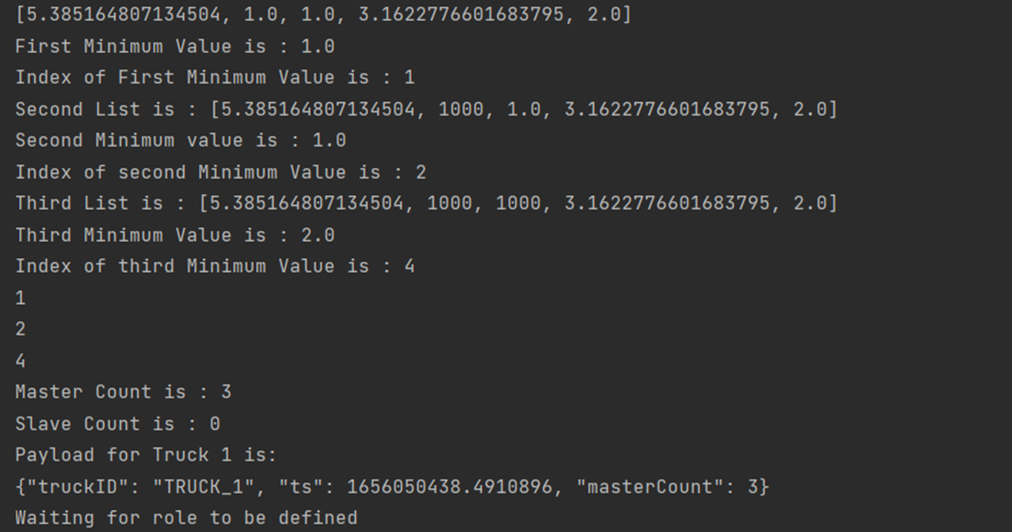
Eculdian Distance Result of Truck1

Slide 16
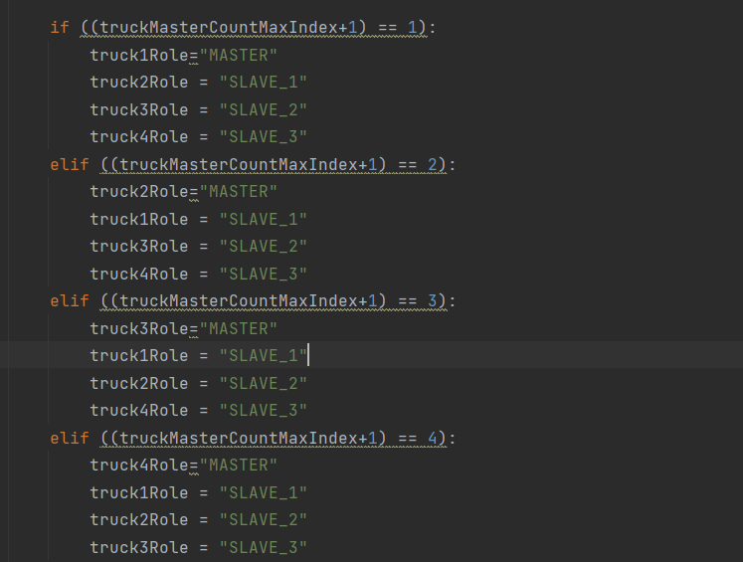
Selecting Master Truck Logic

Slide 17
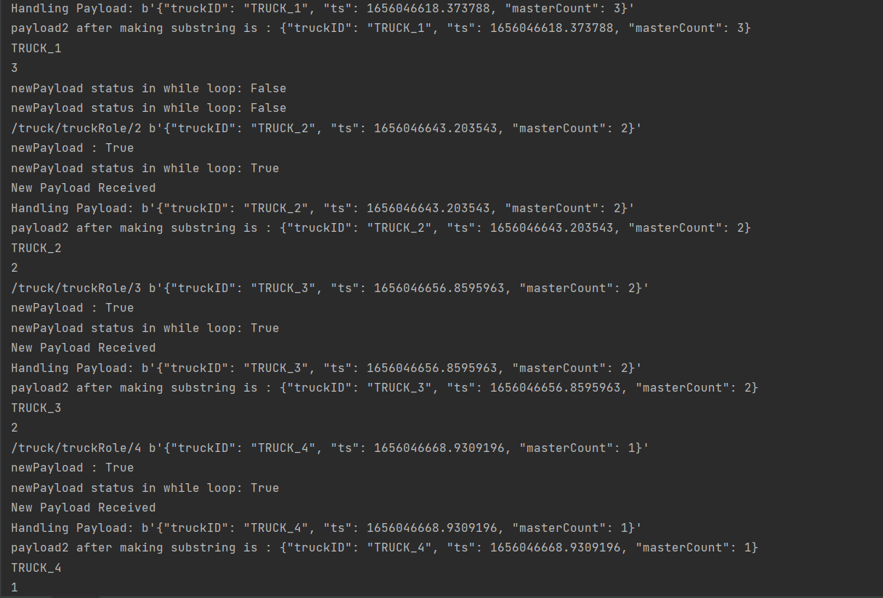
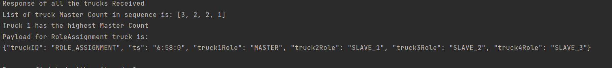
Selecting Master Result

Slide 18
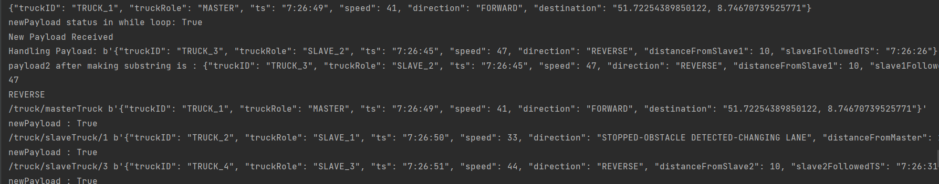
Terminal Screenshots

Slide 19
Terminal Screenshorts

Slide 20
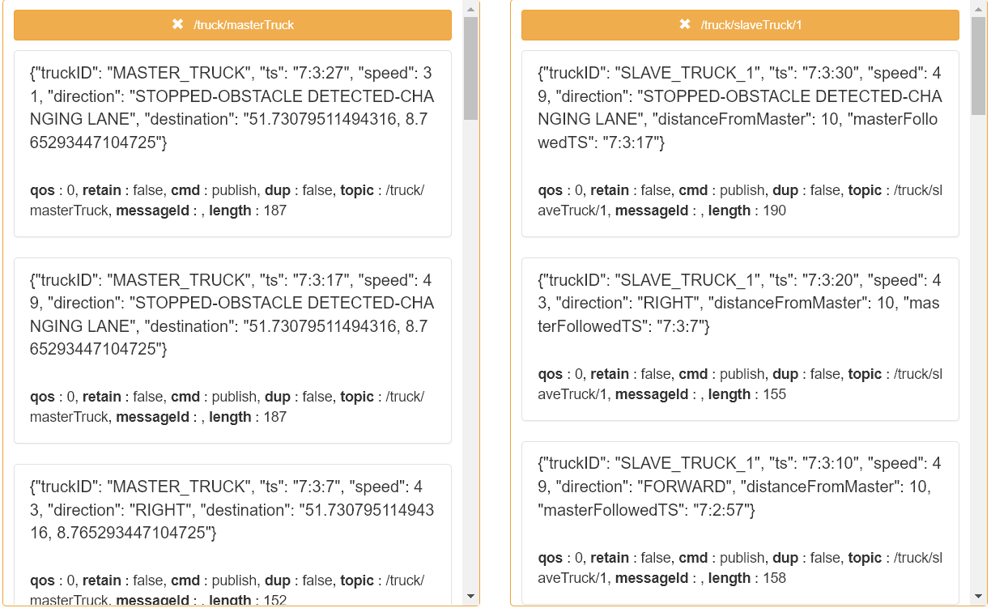
MQTT BOX RESULTS

Slide 21
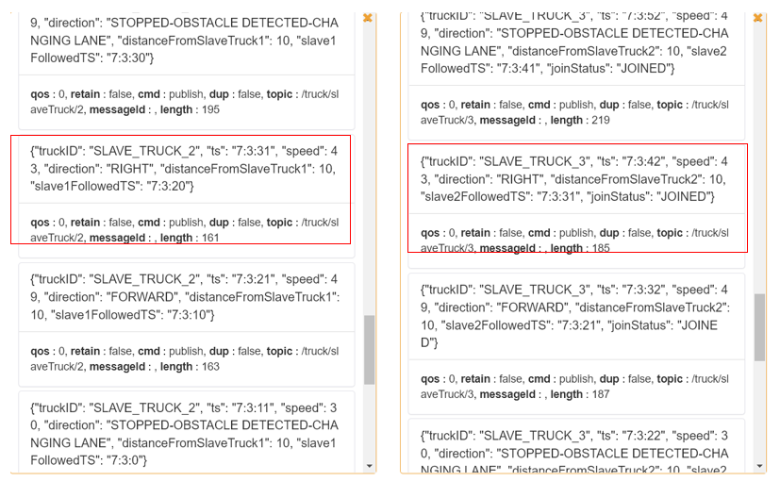
MQTT BOX RESULTS(2)

Slide 22
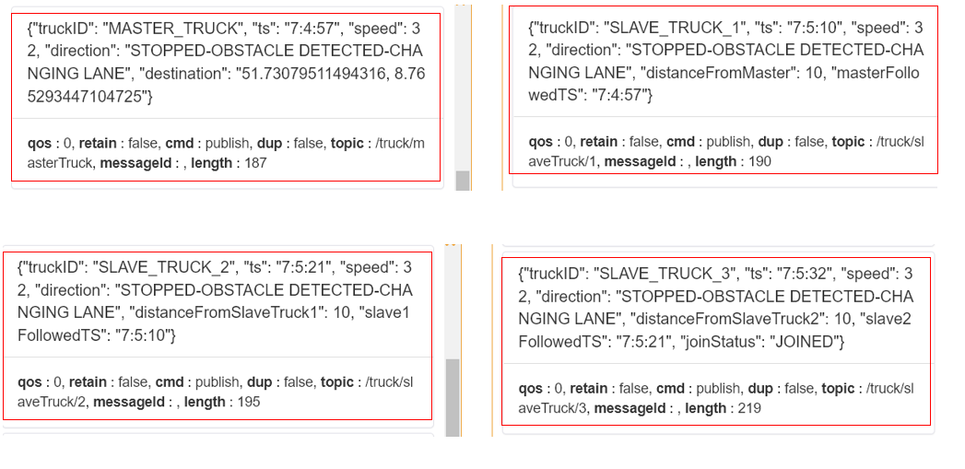
MQTT Result

Slide 23
Thank You !
For Your Attention!

Slide 24
Sources:
Slide No. 18: https://slideplayer.com/slide/13166586/

